Slide 1
ONLINE BANKING
Presented by:
213 JAVA WQ
Group 5

Slide 2
Project Members
Kothakota Ram Sandeep 2487825
Kranti Uddhav Kadam 2486580
Lakkarsu Rashmitha 2484409
M Sai Keerthana 2487213
Manish R 2485809
Manubolu Vinay 2484760
Mattaparthi Sudheer 2487040
Mogili Gnaneswari 2487624
Mohammad Muskan 2484079
Mohammed Shuja Arshad K 2486081

Slide 3
Contents
Background Of Project
Procedure Of Online Banking
Project Flow
Technology Used
Scope And System Overview
Modules Of Online Banking
UML Diagrams
Testing
Output Screenshots
Features & Advantages

Slide 4
INTRODUCTION
Online banking offers customers almost every service traditionally available through a local branch including deposits, transfers, and online bill payments. Virtually every banking institution has some form of online banking, available both on desktop versions and through mobile apps
With online banking, consumers aren't required to visit a bank branch to complete most of their basic banking transactions. They can do all of this at their own convenience, wherever they want—at home, at work, or on the go.

Slide 5
BACKGROUND OF PROJECT
ICIN is one of the top banking firms that accepts deposits from the public. It also invests an amount in securities. Recently, the business analysts noticed a drop in the number of customers of the bank. They found out that online banking systems of banks like AXIS and American Express are gaining more profits by eliminating middlemen from the equation. As a result, the team decided to hire a Full Stack developer who can develop an online banking web application with a rich and user-friendly interface. We are hired as one of the Full Stack Java developers and have been asked to develop the web application. The management team has provided you with the requirements and their business model so that you can easily arrange different components of the application.

Slide 6
PROCEDURE OF ONLINE BANKING
Online banking investigates the entry threshold providing a new transaction service channel for the use of normal users, Organizations. Customer must have a valid user id and password to login into the system. If a wrong password is given in succession, that account will be locked and the customer will not be able to use it.

Slide 7
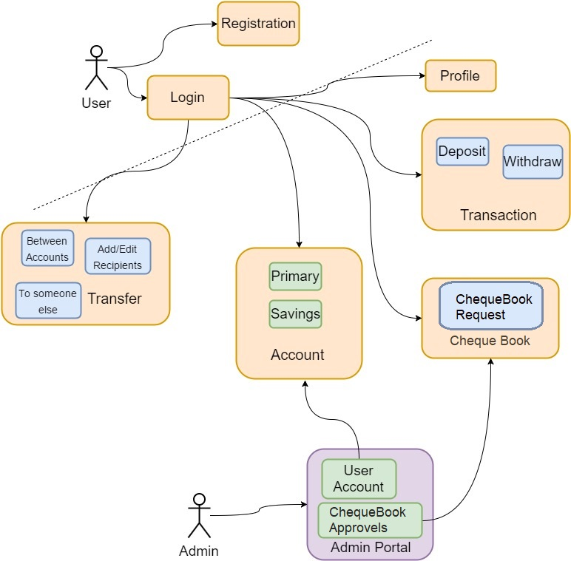
PROJECT FLOW

Slide 8
TECHNOLOGY USED
OPERATING SYSTEM : Windows 10
FRONT END : Html, CSS, Type script(Angular)
SERVER SIDE SCRIPT : Apache tomcat 8
DATABASE : MySQL
TESTING : J Unit testing
BACKEND : Spring Boot

Slide 9
SCOPE AND SYSTEM OVERVIEW
Scope:
Customers can perform financial transactions like transfer funds online, pay bills, apply for loans and open a savings account among various other debit card transactions.
System Overview :
The “Online Banking” supports the basic functionalities for all below listed users.
Admin
User

Slide 10
Admin Module User Module
1. Admin login Page
2. Authorization(KYC)
3. Cheque book Request Approval
4. User Account Info.
1. User Registration
2. Login Page
3. Transaction History
4. Withdraw and Deposit page
5. Fund Transaction Page
6. Request Cheque Book
7. User Session.

Slide 11
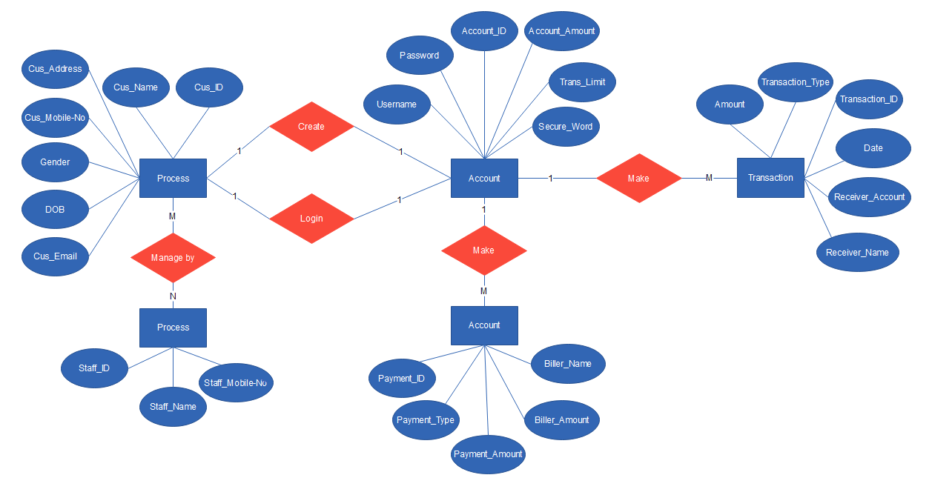
ER Diagram

Slide 12
UNIT TESTING
Verify that for new users based on the user id of the user, their records are added in the database.
Verify that for existing users based on the s.no. of the user, their records are added in the database.

Slide 13
OutPuts

Slide 14
Features
Viewing Account balance
Viewing recent transactions
Ordering cheque books
Managing multiple users
Transfers

Slide 15
ADVANTAGES
Easy Fund Transaction between accounts.
Secure Banking.
Access 24/7.
Better Services.
Transfer Money.

Slide 16
CONCLUSION
The strategy of bank is to provide value added services and products to the consumers, utilizing the internet extensively. The main aim of E-banking or online banking is to make transactions through online processes and provide customers with more benefits. Providing internet banking is increasingly becoming a “need to have” than “nice to have” services.

